Slide 1
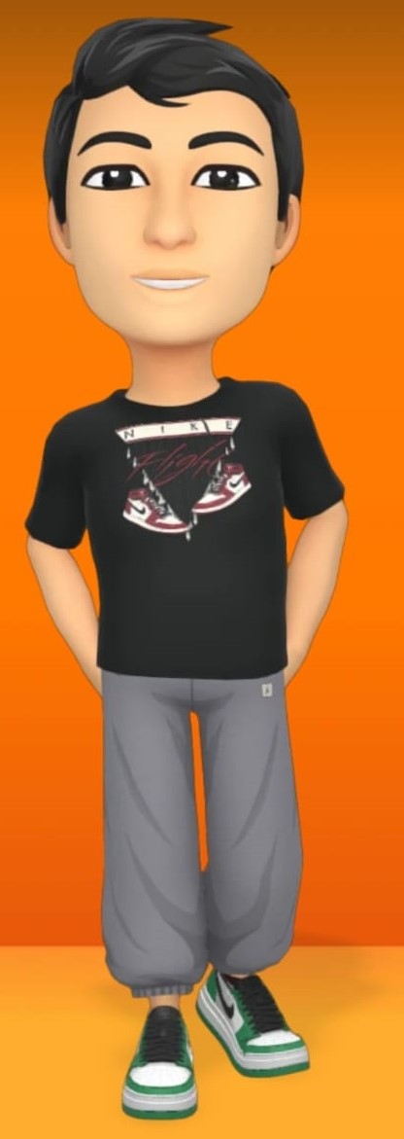


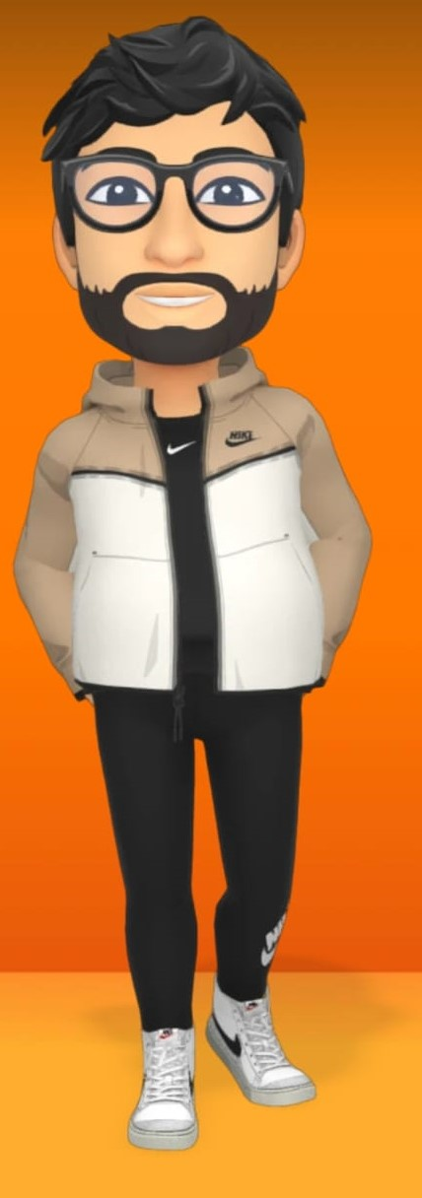
CSE 5330
Course and Project Experience
Team 2
Srikeerthi Srinivasan, Nitya Vodela, Sureddy Shivani Reddy, Vishnu Vardhan Reddy Chitipiralla

Slide 2

Project
Overview
The covid pandemic has brought the tourism sector to a standstill. After restrictions had been lifted, restaurant have tough time to function because of changing user preference due to popularization of delivery services like uber eats, Zomato etc. Restaurants have to adopt a new approach to efficiently increase, manage customers and avoid food wastage.

Slide 3
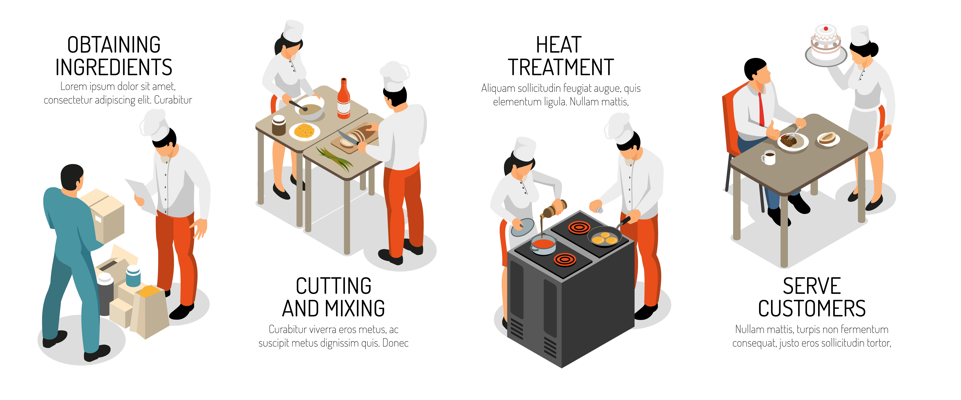
Food Wastage Reduction

Slide 4

Time Management

Slide 5
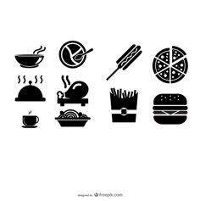




Inventory Management

Slide 6

Project Goals
Inventory
Dine-In
Time Management

Slide 7

Database
Details of the tables
Number of tables: 14
Number of table rows: 647
Number of rows per table:
Employee: 50
Employee Address: 50
Email: 50
Daily Schedules: 50
Customer: 50
Inventory: 73
Order: 50
Department: 6, Supplier: 7
Feedback: 30

Slide 8

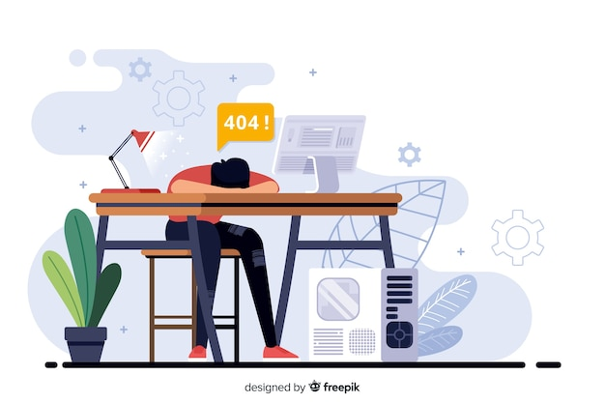
Project Takeaway
If done in a team, how did you manage the tasks and time?
When working with a team, brainstorming the ideas and formulating a solution becomes easier and also helps in time management.
What was difficult?
Planning for all the phases at once.
More time was required on Phase 1 and Phase 2.

Slide 9


Project Takeaway
Collaborative work
Project Planning

Slide 10
Project Give away
Example on how we can use excel in creating insert queries using excel.
Use the excel formula: JOIN() and Concat()
Store output in notepad and save file with .sql extension
Send file to omega server using scp command
scp <options> <source_path> <target_path>
Useful when populating 1000's of row in database instantly

Slide 11
Overall Feedback
How can the project experience be improved?
Provide insight on planning for all the phases
How can the course experience be improved? Engagement and interaction can be improved through activities in class.
How can the test experience be improved? More time for the exam Less complexity of queries.

Slide 12

General
Any general feedback or thought that you want to share?

Slide 13
Discussion

